Slide 1


Intelligent Learning Systems for the Future
Personalized, Adaptive, and Accessible Education
Good morning, we are Team Innovisioners from Sistec Institute. Today, we'll explore how AI can revolutionize learning.

Slide 2
The Challenge
The One-Size-Fits-All Model is Failing Students
Knowledge Gaps
Lack of Insights
Limited Access
Traditional education struggles to cater to individual learning paces, leading to significant gaps in understanding.
Teachers often lack real-time, data-driven insights into student progress and struggles, hindering targeted support.
Many learners still face barriers to quality mentors and resources, perpetuating educational inequality.

Slide 3
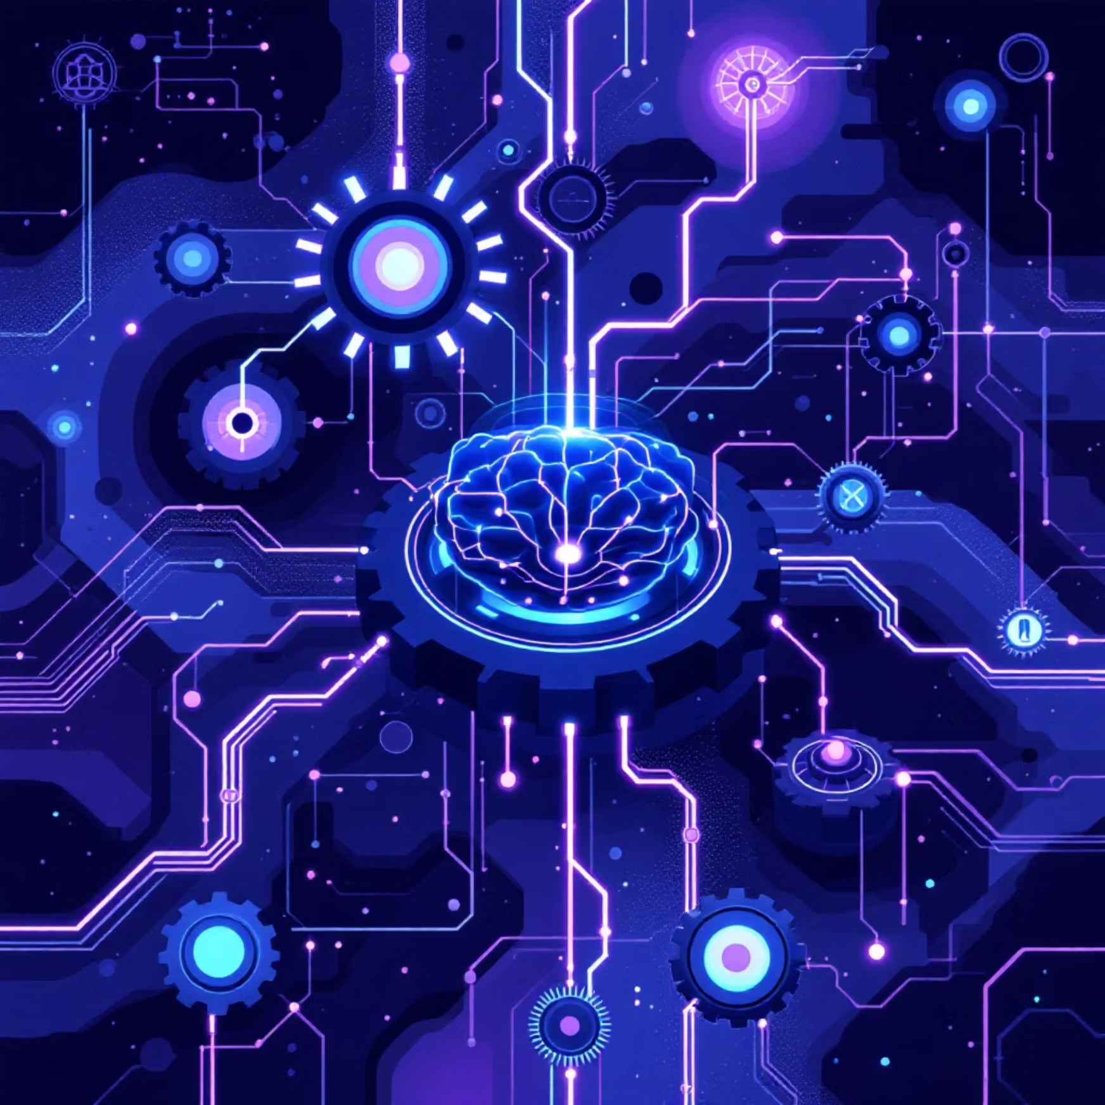
Our AI-Powered Solution
We propose an intelligent learning platform that harnesses the power of Artificial Intelligence to transform the educational landscape. Our platform goes beyond traditional e-learning by actively adapting to each student's unique needs.
Personalized Learning Pathways
Smart Tutoring & Progress Tracking
Always Accessible
Customized curriculum and content tailored to individual learning styles and progress.
AI-driven guidance and real-time monitoring to keep students on track and engaged.
Learning available anytime, anywhere, on any device.

Slide 4



Inspired by the Future of Education
Growing Demand for Personalized Education
NEP 2020 Vision for Tech-Driven Learning
Pandemic Highlighted Digital Needs
Recognizing that every student is unique, our system meets the increasing need for tailored learning experiences.
Aligned with India's National Education Policy, we integrate technology to enhance educational outcomes.
The recent global health crisis underscored the critical need for robust AI-enabled digital support in education.

Slide 5


Our Data-Driven Methodology
Our approach integrates continuous feedback and adaptation to optimize the learning journey for every student.
2. AI-Powered Analysis
1. Data Collection
Utilize advanced AI models to analyze data and provide adaptive recommendations for content and pace.
Gather comprehensive learning data including test scores, interaction patterns, and individual preferences.
4. Real-Time Feedback
3. Interactive Delivery
Implement a continuous feedback loop for both students and teachers, enabling immediate adjustments and improvements.
Deliver engaging, gamified, and interactive learning modules to enhance retention and enjoyment.

Slide 6



Key Features of Our Platform
Our platform is designed with a comprehensive suite of features to ensure an enriching and supportive learning environment for all.
Adaptive Learning Dashboard
AI Tutor with Chat & Voice
Performance Prediction & Insights
Personalized interface with real-time progress tracking.
Intelligent virtual assistant for instant support and explanations.
Forecast student performance and provide actionable data to educators.
Multilingual Support
Accessibility Features
Content available in multiple languages to cater to diverse users.
Ensuring inclusive learning for differently-abled students.

Slide 7

AI: The Core of Our Innovation
Artificial Intelligence isn't just a feature; it's the foundation upon which our entire learning system is built. It enables unprecedented personalization and efficiency.
Natural Language Processing (NLP): For intelligent Q&A and detailed explanations.
Predictive Analytics: To forecast student performance and proactively identify potential learning hurdles.
Recommendation Engine: Curating the most relevant study materials and learning paths.
AI-Driven Checks: Ensuring academic integrity through plagiarism and evaluation tools.

Slide 8
Robust Tech Stack
Our robust technology stack is carefully selected to ensure scalability, performance, and future-readiness for our intelligent learning system.
Frontend
Backend
AI/ML
Deployment
HTML, CSS
Flask or Django
Python
Cloud (AWS or GCP)
React
TensorFlow
NLP Models
Database
MySQL or MongoDB

Slide 9
Expected Transformative Outcomes
Higher Engagement & Retention
Fewer Learning Gaps
Stronger Teacher Support
Adaptive pathways will identify and address knowledge gaps proactively, ensuring comprehensive understanding.
Students will be more motivated and stay longer with personalized and interactive content.
AI-driven analytics provide educators with valuable insights, enabling more targeted and effective teaching.
Our vision is to build a scalable and inclusive education system that empowers every learner.

Slide 10

Broad Societal Impact
Empowering All Students
Providing equal educational opportunities for both rural and urban students, democratizing access to quality learning.
Reducing Dropout Rates
Personalized support and engaging content will keep students motivated, significantly reducing educational attrition.
Contributing to National Missions
Directly supporting the goals of Digital India and Skill India, fostering a future-ready workforce.

Slide 11



Future Horizons: Expanding the Learning Experience
We envision continuous innovation and integration of cutting-edge technologies to further enhance the intelligent learning ecosystem:
Blockchain for Secure Certifications
AI-Driven Career Counseling
Immersive AR/VR Learning
Leveraging blockchain technology for tamper-proof and verifiable academic credentials and skill certifications.
Integration of Augmented and Virtual Reality for highly engaging and interactive simulations and virtual field trips.
Personalized career guidance based on student aptitude, performance data, and real-time labor market trends.

Slide 12



Meet the Innovisioners Team
Sakshi Mishra
Nitin Rajput
Pawan Parmar
Leader & Visionary Thinker - Sakshi's fresh ideas and strategic insights form the foundation of our innovative solutions, driving the team's imagination forward.
Research & Documentation Lead - Nitin brings logical insights and analytical skills, ensuring every challenge is met with a smart, well-documented solution.
Designer & Developer - Pawan adds life to our concepts, combining sleek frontend design with robust coding expertise to deliver impactful user experiences.
Together, we blend vision, logic, and execution to create transformative AI-driven solutions for education.

Slide 13

Shaping the Future of Education with AI
Thank You
Team Alpha | University of Innovation

